Slide 2
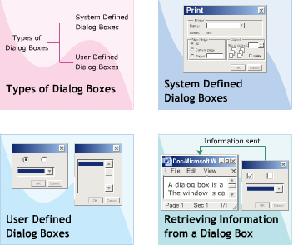
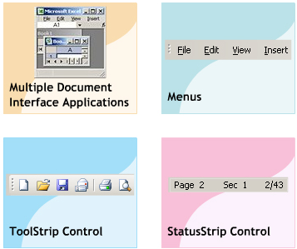
Objective
Types of Dialog Boxes
System Defined Dialog Boxes
User-Defined Dialog Boxes
Retrieving Information from Dialog Box
MDI Application
Menus
ToolStrip
StatusStrip
Notes:
Retrieving : Truy xuất

Slide 3
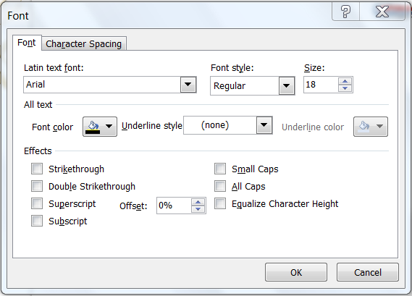
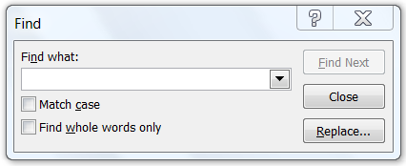
Dialog Box
A Dialog box is a window that uses for:
displaying information and messages for the user.
accepting user-input.
Types :
by Presentation:
Modal
Modeless
by Definition:
Common Dialog Boxes
Custom Dialog Boxes

Slide 4
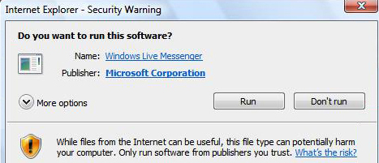
Dialog Box Structure & Features
Structure:
Title bar displaying caption and the close icon
Instruction text informing what the user do (optional)
Content with controls to select or display information
Action area having buttons and link labels
Footnote area explaining about the window (optional)
Features:
Is not resizable
Is usually Modal
Contains OK and Cancel buttons

Slide 5
Common Dialog Boxes
Are system-defined dialog boxes such as : Color, Font, OpenFile, Save, Page, Print…
Can be used across various applications.
CommonDialog class is the base class for all common dialog boxes:
Property | Tag
Method | ShowDialog, Reset
Event | HelpRequest
Notes:
Common : the same in a lot of places or for a lot of people

Slide 6
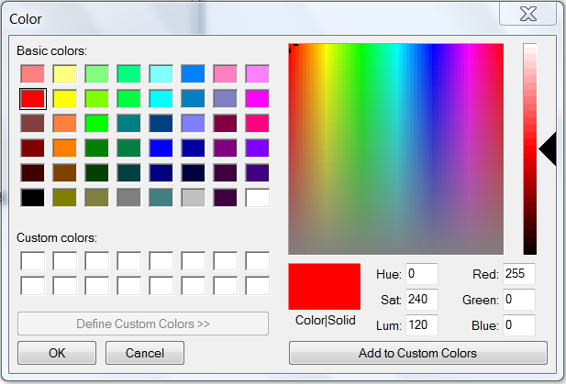
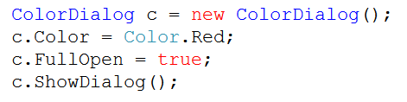
ColorDialog Box
Allows users to select the system-defined colors from the color palette.
Also allows users to use custom color by defining the RGB color values.
Properties:
AllowFullOpen, AnyColor, Color, CustomColors, SolidColorOnly, ShowHelp …

Slide 7
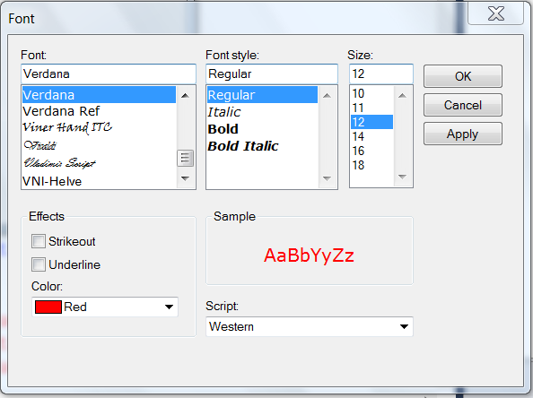
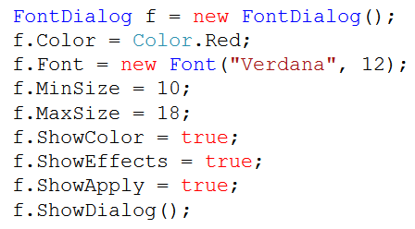
FontDialog Box
Provides various fonts installed in the system, including font styles, sizes and effects that can be selected by users.
Properties:
Font, MaxSize, MinSize, Color, ShowColor, FixedPitchOnly, ShowEffects, ShowApply, ShowHelp
Event:
Apply

Slide 8
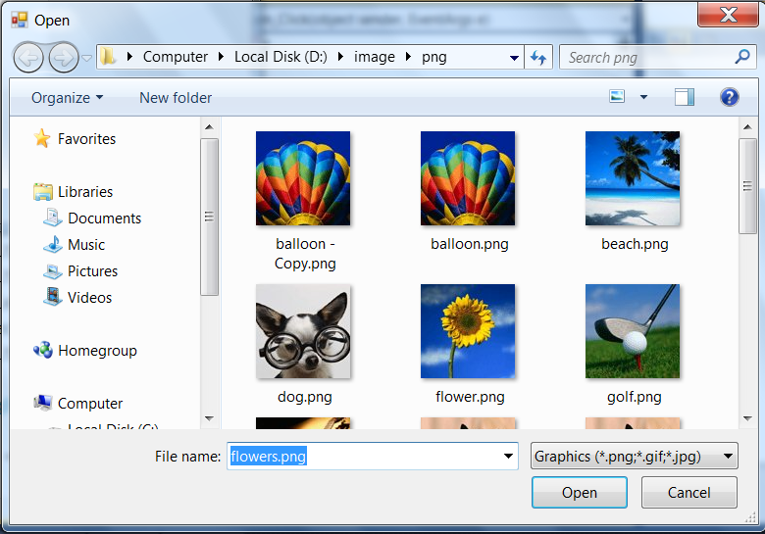
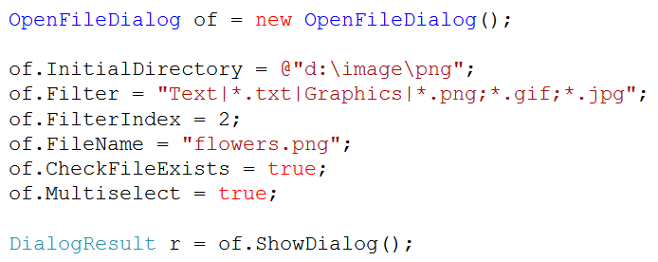
OpenFileDialog
Opens file that was specified by users.
Properties:
Title,Filter, FileName, FileNames, ...
Method:
FileOpen

Slide 9
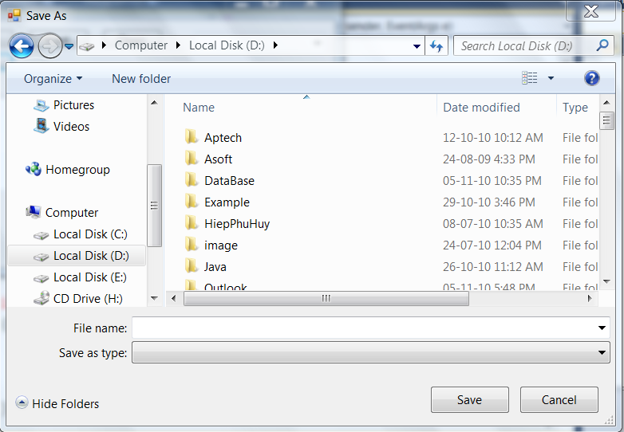
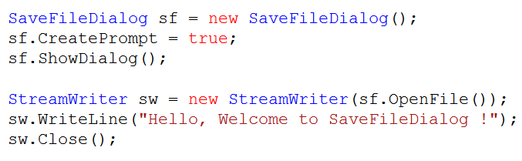
SaveFileDialog
Enables users to save a file in preferred location.
Properties:
AddExtension, CreatePrompt, OverwritePrompt
Notes:
Preferred : liked or wanted more than anything else

Slide 10
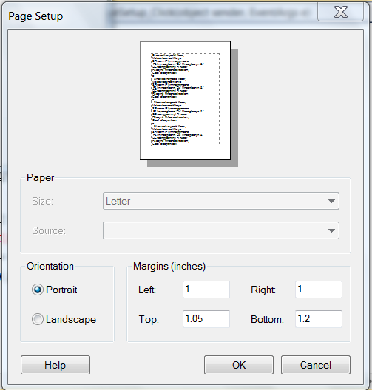
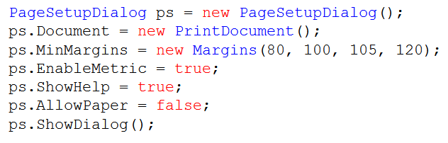
PageSetupDialog
Set Page Layout of printing:
border, margin, header and footer
portrait and lanscape orientation

Slide 11
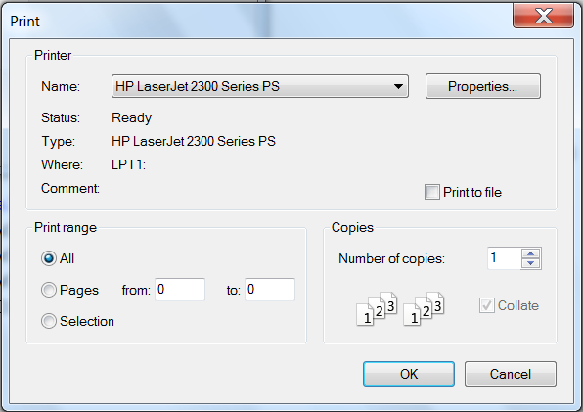
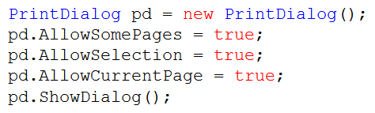
PrintDialog
Used for printing document:
Select a printer
Choose the pages to print
Number of copies …

Slide 12

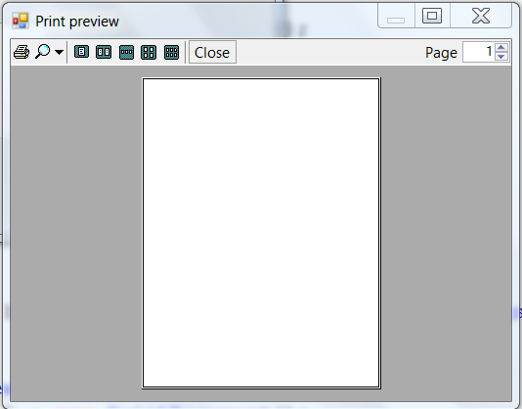
PrintPreviewDialog
Used to display the way a document will appear when printed.

Slide 13
Custom Dialog Box
Is a user-defined dialog box.
Form presenting for a dialog need to be setup as follows:
FormBorderStyle property : FixedDialog
ControlBox, MinimizeBox, MaximizeBox: false
Must provide the OK and Cancel buttons
AcceptButton property: OK button
CancelButton property: Cancel button

Slide 14
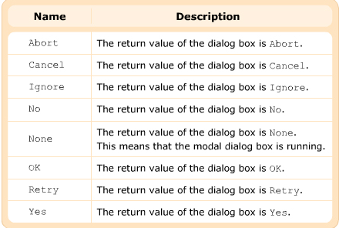
DialogResult Enumeration
Present a return value from invoking a dialog box.

Slide 15
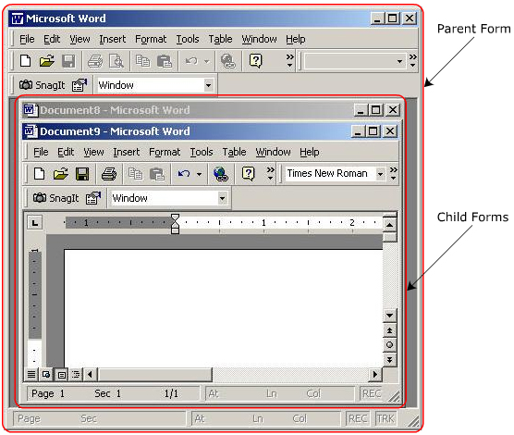
MDI Application
An application can contain multiple forms and document interface is the way to design these forms.
There are basically two types of document interface :
Single Document Interface (SDI)
Multiple Document Interface (MDI)
MDI application :
Advantages:
Systematic Organization
Increased Efficiency
Less Memory usage
Easy implementation
Disadvantages:
Must at least one child form
In case of multiple child forms, it becomes to make the desired changes between forms→ increase the risk of inconsistent data.
Notes:
Desired : that is wanted
Inconsistent : If a reason, idea, opinion, etc. is inconsistent, different parts of it do not agree, or it does not agree with something else

Slide 16
MDI Parent - MDI Child forms
An MDI application consists of a parent form and multiple child forms:
Parent form acts as the base window
Child form is the sub-form opened within the parent form. When the parent is closed, all the child forms also closed.
Properties | IsMDIContainer, MdiParent,IsMdiChild, MdiChidren, ActiveMdiChild
Methods | LayoutMdi, Show,ActivateMdiChild
Events | MdiChildActive

Slide 17
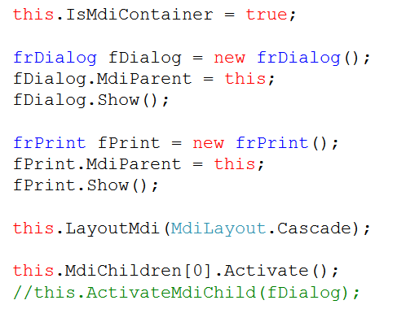

Slide 18
Menus System
There are two types of menus :
Main menu (appears on the menu bar of the form)
MenuStrip : support MDI, merging menus and tool tips
ToolStripItemMenu
Context Menu : popup menu (appear when right click mouse)
ContextMenuStrip
See also : Menu,MainMenu, ContextMenu,MenuItem

Slide 19
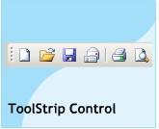
ToolStrip
is used to create the toolbar.
can add buttons, lables, seperators, combo boxes, and drop down buttons.
Properties | ImageList, Items, LayoutStyle
Methods | GetNextItem(..)
Events | ItemAdded, ItemClicked, ItemRemoved

Slide 20
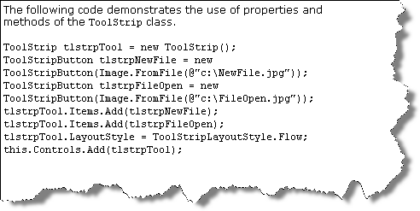

Slide 21
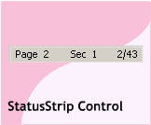
StatusStrip
Is a new control introduced in .Net 2.0
Default, has no panel and displayed at the bottom of the form.
To add panels to a StatusStrip control, you use the ToolStripItemCollection.AddRange method, or use the StatusStrip Items Collection Editor at design time.
Properties | LayoutStyle, Stretch, Dock
Events | ItemAdded

Slide 22
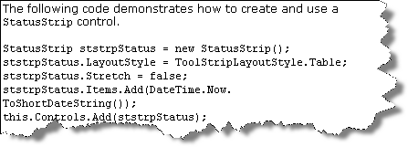

Slide 23
Summary
Dialog boxes are used to interact with user and retrieve information.
Types
by presentation: modal, modeless
by definition : common, custom.
Common system-defined dialogs :
Color, Font, OpenFile, SaveFile
PageSetup, Print, PrintPreview
Types of document interface: SDI and MDI
Types of menu : menu bar and context menu

